Slide 1
Engineering Economics

Slide 2
ECONOMICS
Economics is the science that deals with the production and consumption of goods and services and the distribution and rendering of these for human welfare.
The following are the economic goals.
A high level of employment
Price stability
Efficiency
An equitable distribution of income
Growth
Some of the above goals are interdependent. The economic goals are not always complementary; in many cases they are in conflict. For example, any move to have a significant reduction in unemployment will lead to an increase in inflation.

Slide 3
Flow in an Economy
The flow of goods, services, resources and money payments in a simple economy are shown in Fig. 1.1. Households and businesses are the two major entities in a simple economy. Business organizations use various economic resources like land, labour and capital which are provided by households to produce consumer goods and services which will be used by them.
Business organizations make payment of money to the households for receiving various resources. The households in turn make payment of money to business organizations for receiving consumer goods and services.
This cycle shows the interdependence between the two major entities in a simple economy.

Slide 4
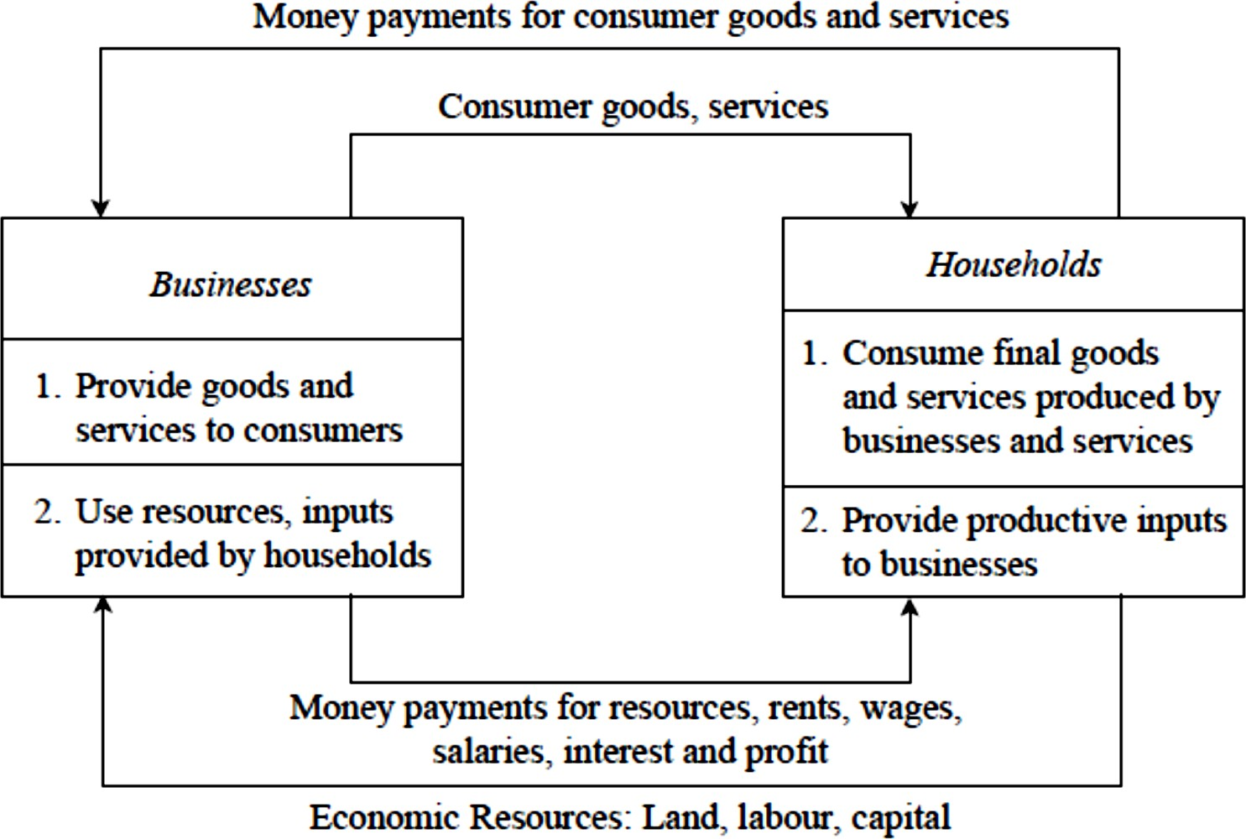
Flow in an Economy (Fig. 1.1)

Slide 5
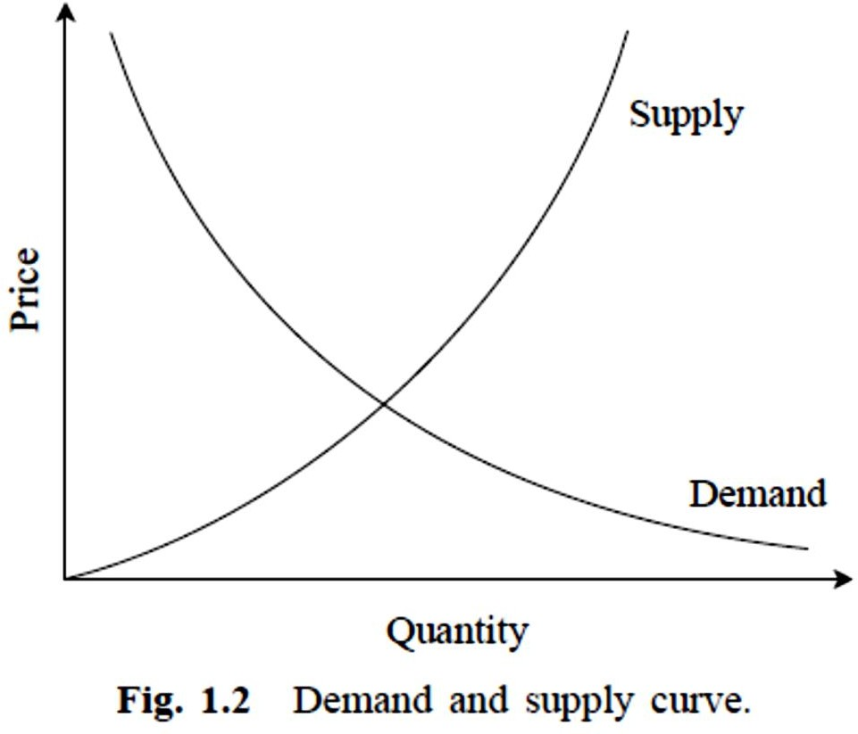
Law of Supply and Demand
An interesting aspect of the economy is that the demand and
supply of a product are
are the
interdependent and they
sensitive with respect to
price of that product.
The interrelationships between them are shown in Fig. 1.2.

Slide 6
Law of Supply and Demand
From Fig. 1.2 it is clear that when there is a decrease in the price of a product, the demand for the product increases and its supply decreases.
Also, the product is more in demand and hence the demand of the product increases.
At the same time, lowering of the price of the product makes the producers restrain from releasing more quantities of the product in the market. Hence, the supply of the product is decreased.
The point of intersection of the supply curve and the demand curve is known as the equilibrium point.
At the price corresponding to this point, the quantity of supply is equal to the quantity of demand. Hence, this point is called the equilibrium point.

Slide 7
Factors influencing demand
The shape of the demand curve is influenced by the following factors:
Income of the people
Prices of related goods
Tastes of consumers

Slide 8
Factors influencing supply
The shape of the supply curve is affected by the following factors:
Cost of the inputs
Technology
Weather/Season
Prices of related goods

Slide 9
CONCEPT OF ENGINEERING ECONOMICS
Science is a field of study where the basic principles of different physical systems are formulated and tested. Engineering is the application of science.
It establishes varied application systems based on different scientific principles.
From the discussions in the previous section, it is clear that price has a major role in deciding the demand and supply of a product.
Hence, from the organization’s point of view, efficient and effective functioning of the organization would certainly help it to provide goods/services at a lower cost which in turn will enable it to fix a lower price for its goods or services.

Slide 10
Types of Efficiency
Efficiency of a system is generally defined as the ratio of its output to input.
The efficiency can be classified into technical efficiency and
economic efficiency.

Slide 11
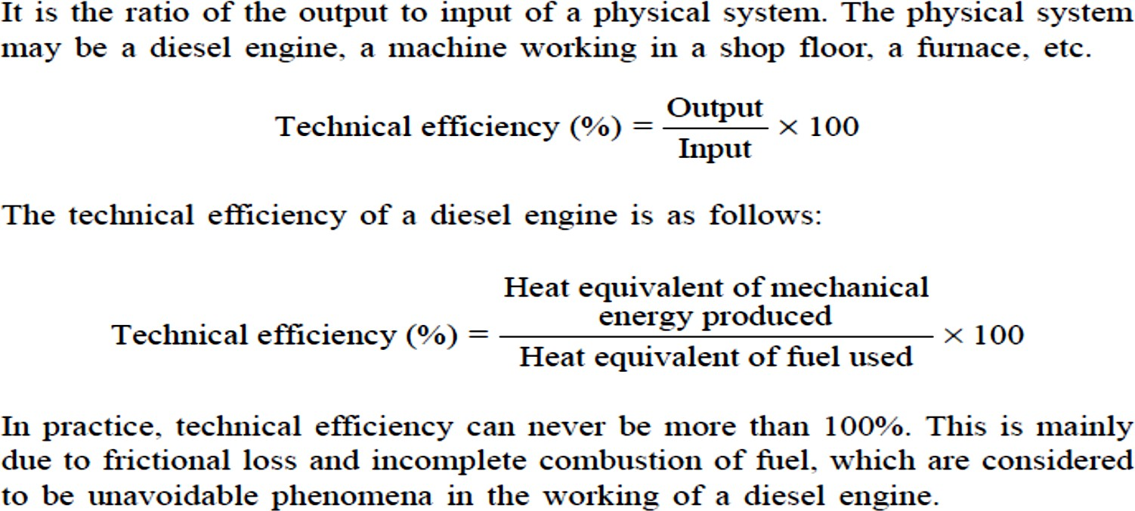
Technical efficiency

Slide 12
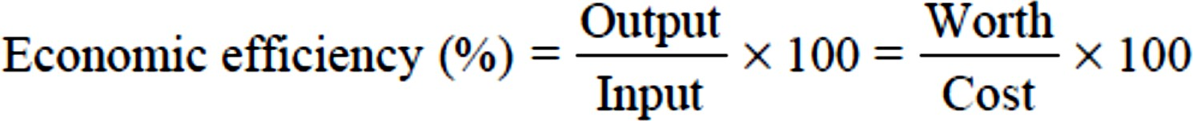
Economic efficiency
Economic efficiency is the ratio of output to input of a business system.
‘Worth’ is the annual revenue generated by way of operating the business and ‘cost’ is the total annual expenses incurred in carrying out the business.
For the survival and growth of any business, the economic efficiency should be more than 100%.

Slide 13
Economic efficiency
Economic efficiency is the ratio of output to input of a business system.
‘Worth’ is the annual revenue generated by way of operating the business and ‘cost’ is the total annual expenses incurred in carrying out the business.
For the survival and growth of any business, the economic efficiency should be more than 100%.

Slide 14
Economic efficiency
There are several ways of improving productivity.
Increased output for the same input
Decreased input for the same output
By a proportionate increase in the output which is more than the proportionate increase in the input
By a proportionate decrease in the input which is more than the proportionate decrease in the output
Through simultaneous increase in the output with decrease in the input.

Slide 15
Definition and Scope of Engineering Economics
As stated earlier, efficient functioning of any business organization would enable it to provide goods/services at a lower price.
In the process of managing organizations, the managers at different levels should take appropriate economic decisions which will help in minimizing investment, operating and maintenance expenditures besides increasing the revenue, savings and other related gains of the organization.

Slide 16
Definition and Scope of Engineering Economics
Definition
Engineering economics deals with the methods that enable one to take economic decisions towards minimizing costs and/or maximizing benefits to business organizations.
Scope
The issues that are covered in this course are elementary economic analysis, interest formulae, bases for comparing alternatives, present worth method, future worth method, annual equivalent method, rate of return method, replacement analysis, depreciation, and linear programming.

Slide 17
ELEMENTS OF COSTS
Cost can be broadly classified into variable cost and overhead cost. Variable cost varies with the volume of production while overhead cost is fixed, irrespective of the production volume.
Variable cost can be further classified into direct material cost, direct labour cost, and direct expenses.
The overhead cost can be classified into factory overhead, administration overhead, selling overhead, and distribution overhead.

Slide 18
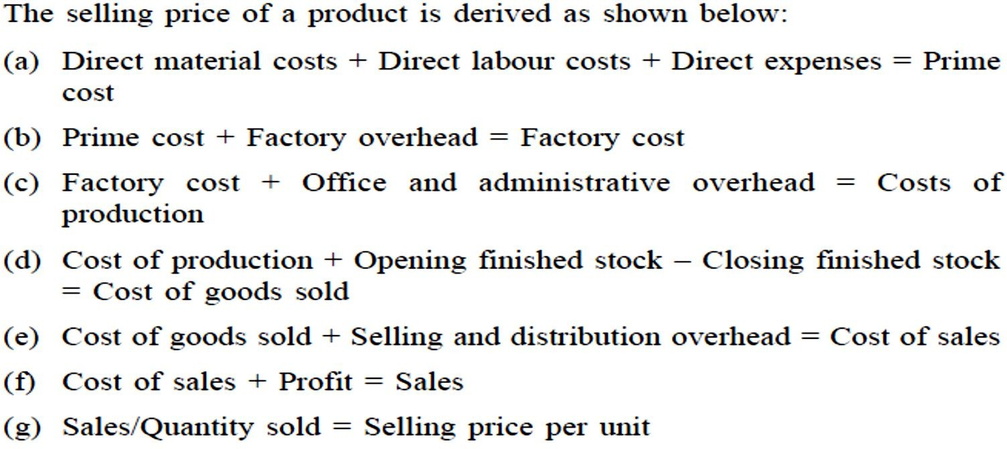
ELEMENTS OF COSTS
In the above calculations, if the opening finished stock is equal to the closing finished stock, then the
cost of production is equal to the cost of goods sold.

Slide 19
OTHER COSTS/REVENUES
The following are the costs/revenues other than the costs which are presented in the previous section:
Marginal cost
Marginal revenue
Sunk cost
Opportunity cost

Slide 20
OTHER COSTS/REVENUES
Marginal Cost
Marginal cost of a product is the cost of producing an additional unit of that product.
Let the cost of producing 20 units of a product be Rs. 10,000, and the cost of producing 21 units of the same product be Rs. 10,045. Then the marginal cost of producing the 21st unit is Rs. 45.

Slide 21
OTHER COSTS/REVENUES
Marginal Revenue
Marginal revenue of a product is the incremental revenue of selling an additional unit of that product.
Let, the revenue of selling 20 units of a product be Rs. 15,000 and the revenue of selling 21 units of the same product be Rs. 15,085. Then, the marginal revenue of selling the 21st unit is Rs. 85.

Slide 22
OTHER COSTS/REVENUES
Sunk Cost
This is known as the past cost of an equipment/asset.
Let us assume that an equipment has been purchased for Rs. 1,00,000 about three years back. If it is considered for replacement, then its present value is not Rs. 1,00,000. Instead, its present market value should be taken as the present value of the equipment for further analysis. So, the purchase value of the equipment in the past is known as its sunk cost. The sunk cost should not be considered for any analysis done from now onwards.

Slide 23
OTHER COSTS/REVENUES
Opportunity Cost
In practice, if an alternative (X) is selected from a set of competing alternatives (X,Y), then the corresponding investment in the selected alternative is not available for any other purpose. If the same money is invested in some other alternative (Y), it may fetch some return. Since the money is invested in the selected alternative (X), one has to forego the return from the other alternative (Y). The amount that is foregone by not investing in the other alternative (Y) is known as the opportunity cost of the selected alternative (X).
So the opportunity cost of an alternative is the return that will be foregone by not investing the same money in another alternative.

Slide 24
OTHER COSTS/REVENUES
Opportunity Cost
Consider that a person has invested a sum of Rs. 50,000 in shares. Let the expected annual return by this alternative be Rs. 7,500. If the same amount is invested in a fixed deposit, a bank will pay a return of 18%. Then, the corresponding total return per year for the investment in the bank is Rs. 9,000.
This return is greater than the return from shares. The foregone excess return of Rs. 1,500 by way of not investing in the bank is the opportunity cost of investing in shares.

